Slide 1
What a BOOTiful microservice with Armeria + Spring WebFlux
Joonhaeng Lee (joonhaeng.lee@navercorp.com)
NAVER Clova

Slide 2
Contents
Spring WebFlux basic configuration and operation check
Apply Armeria Server
Armeria-gRPC applied
Apply ArmeriaClient
Create Decorator
Other Tip

Slide 3
1. Spring WebFlux basic configuration and operation check

Slide 4
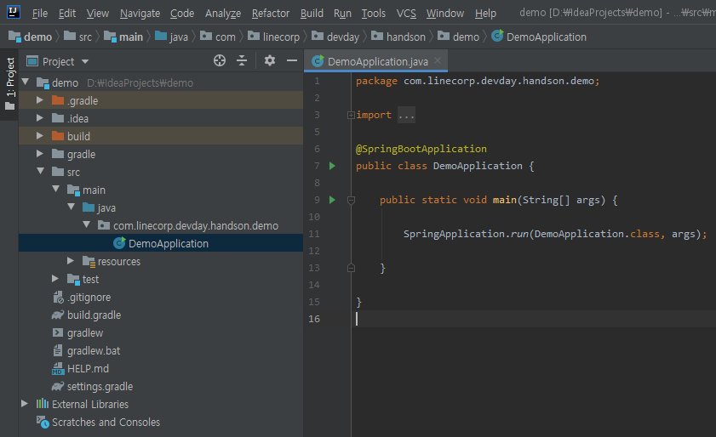
1.2 Basic setting
Create controller and service after basic setting
Check project structure

Slide 5
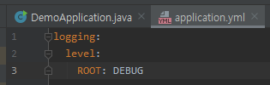
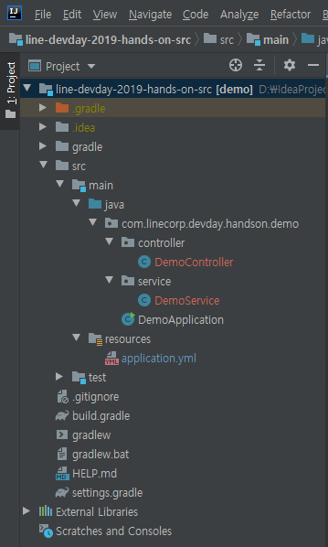
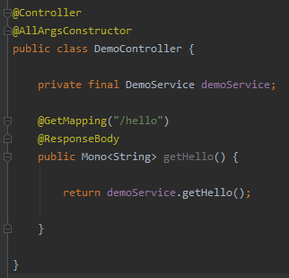
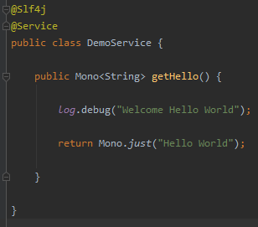
1.3 Controller, Service creation
Create controller and service after basic setting
Add logger setting after changing application.properties-> application.yml
DemoController, DemoService creation

Slide 6
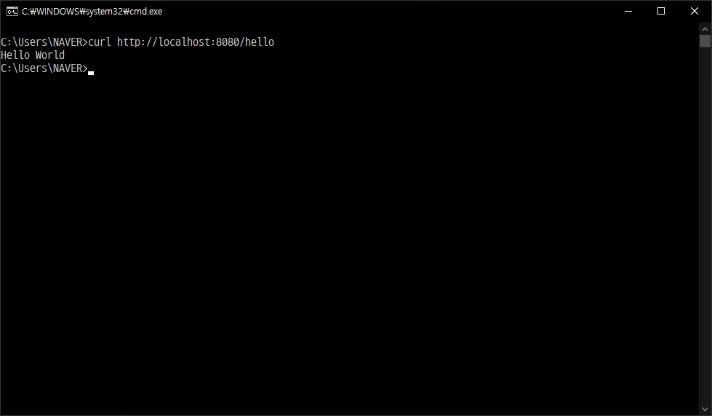
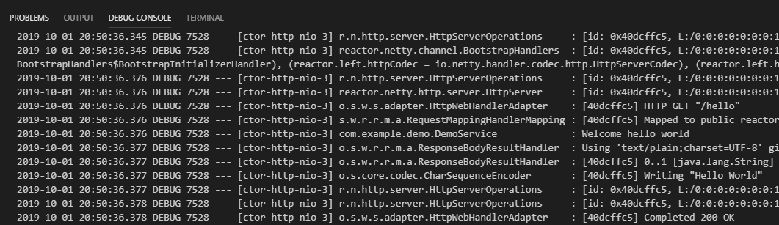
1.4 Operation check
Operation check
Reactor-netty operating and Listen port 8080
Try calling [/hello]

Slide 7
2. Apply Armeria Server

Slide 8
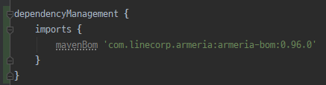
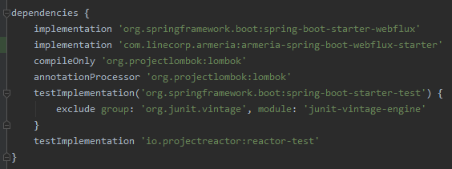
2.1 Add dependencies
build.gradle
add dependencyManagement
The netty version referenced by the current version of Spring Boot (2.2.1) and armeria (0.96) is the same as 4.1.43.Final, but netty-bom may be required if the netty versions referenced by each other are different.
add armeria-spring-boot-webflux-starter to dependencies

Slide 9
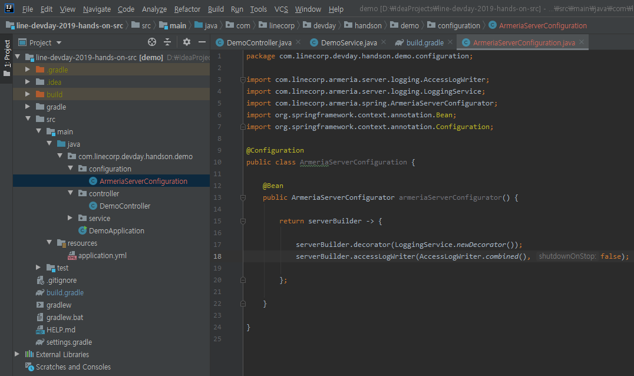
2.2 Armeria Server Settings
ArmeriaConfiguration
Server Settings
LoggingService.newDecorator()
Log all data to and from the server
AccessLogWriter.combined()
Output logs to the server in apache httpd combined log format (see https://httpd.apache.org/docs/2.4/en/logs.html)

Slide 10
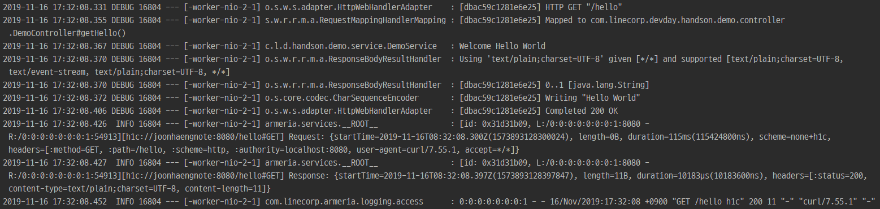
2.3 Operation check
Operation check
Server implementation changed from reactor-netty to armeria
I / O data, access log logged

Slide 11
3. Armeria-gRPC applied

Slide 12
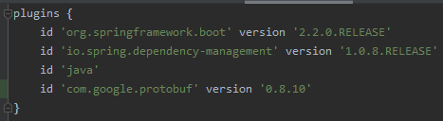
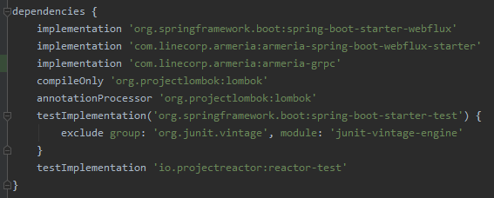
3.1 Add settings to build.gradle
gRPC adds protobuf related dependencies
add protobuf plugin
add armeria-grpc to dependencies

Slide 13
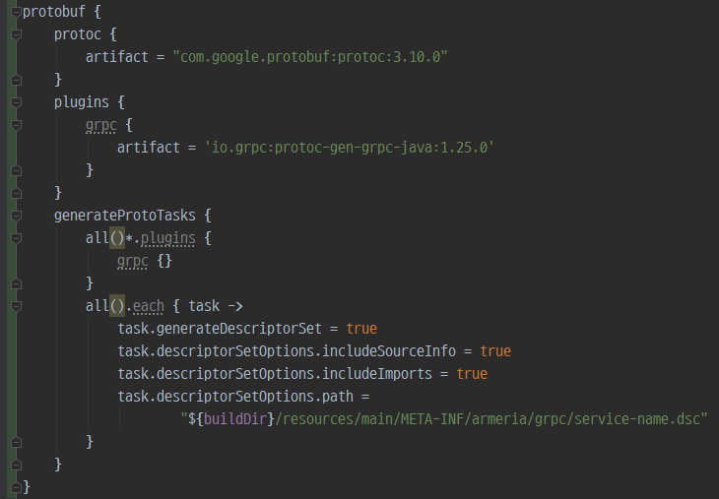
3.1 Add settings to build.gradle
gRPC adds protobuf related dependencies
Create [protobuf] section and add metadata related settings
The setting of all(). each is related to metadata generation.
See https://line.github.io/armeria/server-docservice.html#adding-docstrings for more information.

Slide 14
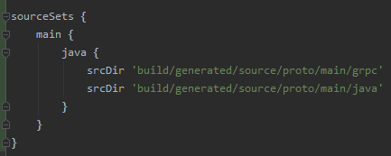
3.1 Add settings to build.gradle
Add sourceSets for .proto
Create [sourcesSet] section and add two directory
build/generated/source/proto/main/grpc
Located stub & method related code by protobuf compiler
build/generated/source/proto/main/java
Located model(message) related code by protobuf compiler

Slide 15
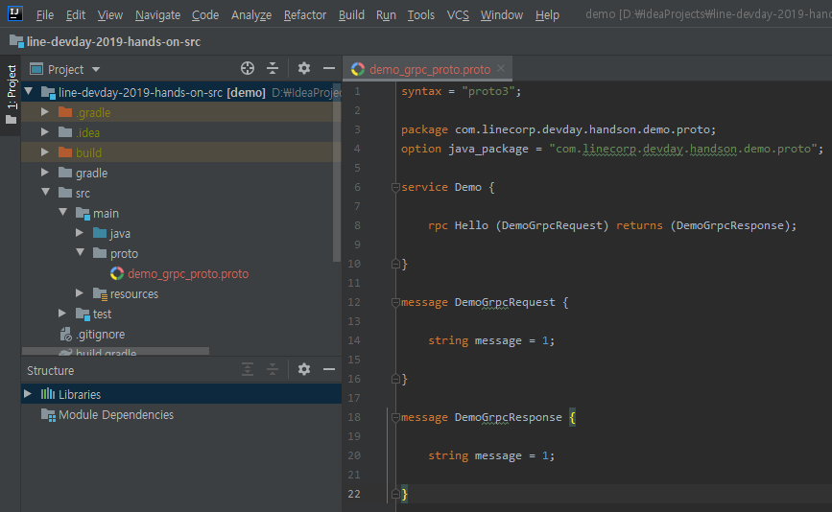
3.2 Create .proto file
Add demo_grpc_proto.proto
Create demo_grpc_proto.proto file where /src/main/proto

Slide 16

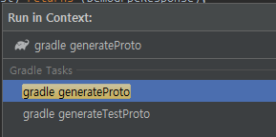
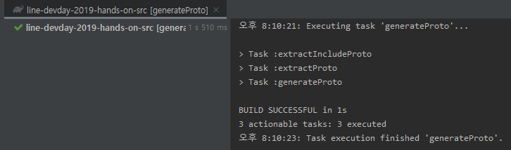
3.2 Create .proto file
Verify that demo_grpc_proto.proto is compiled
Run the generateProto task with the Gradle wrapper to compile .proto
Check that .java is created correctly

Slide 17
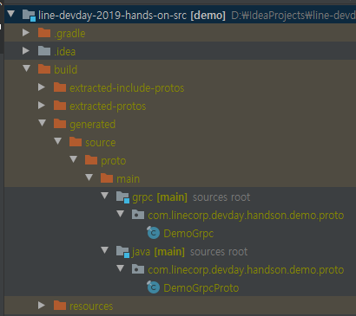
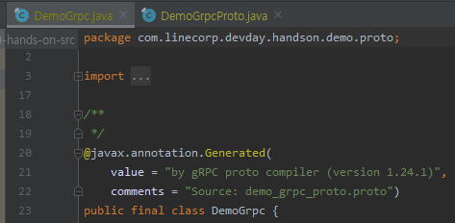
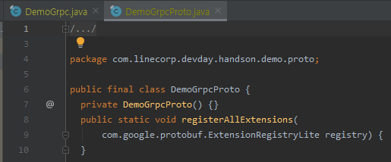
3.2 Create .proto file
Verify that demo_grpc_proto.proto is compiled
Check that .java is created correctly

Slide 18
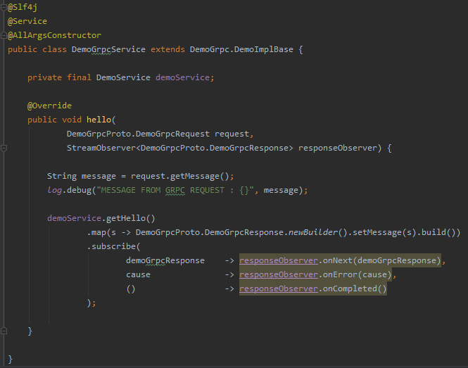
3.3 Create Service (Spring) Class
DemoGrpcService.java
Extend grpc stub to create Spring Service

Slide 19
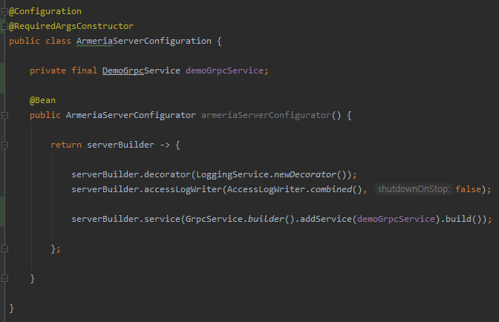
3.4 Add Service to ArmeriaServer
Add DemoGrpcService (Spring Service) created in the previous chapter to ArmeriaServer
add GrpcService.builder() in ArmeriaServerConfiguration

Slide 20
3.5 Application startup confirmation
There's no way to check that it works…
Th
Startup is complete but there is no way to check
In the past, the only way to check gRPC was to write and verify a separate client based on IDL.
It would be nice to see it like Swagger…
You can use docService provided by Armeria

Slide 21
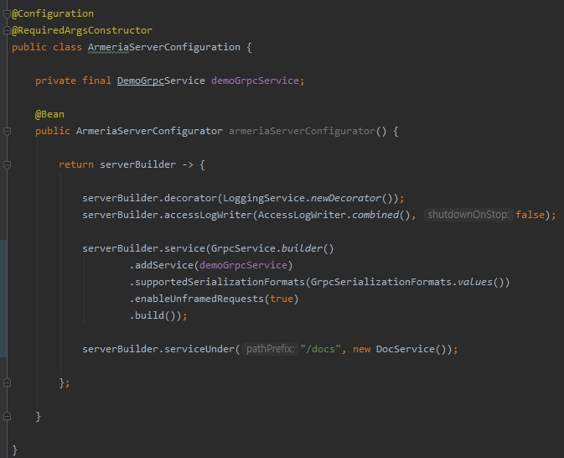
3.6 Apply docService
Some additional settings in the ArmeriaServer environment
Add setting to use Swagger-like web console based on gRPC-Web technology

Slide 22
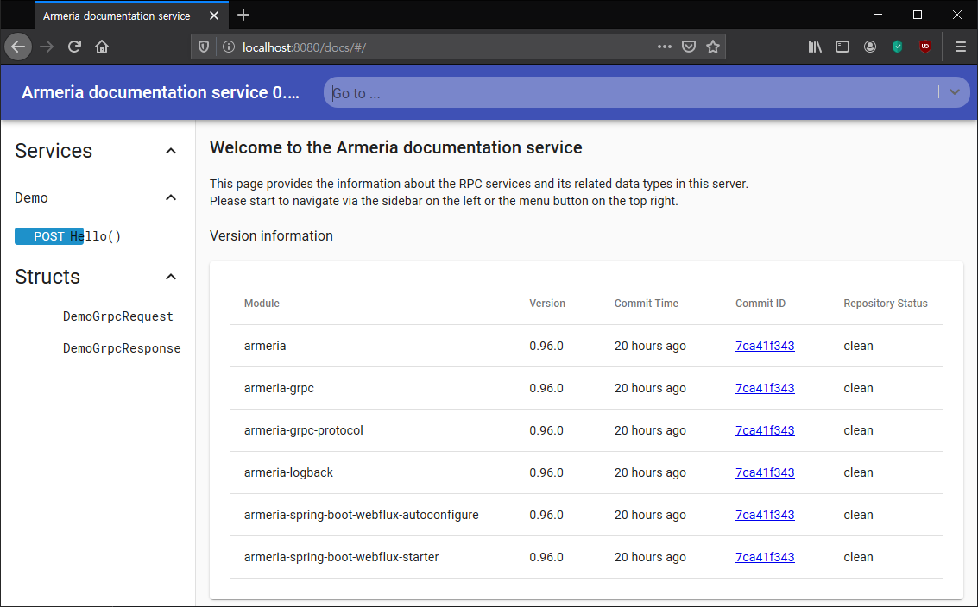
3.7 docService Connection
Access http://localhost: 8080/docs/ after launching the application

Slide 23
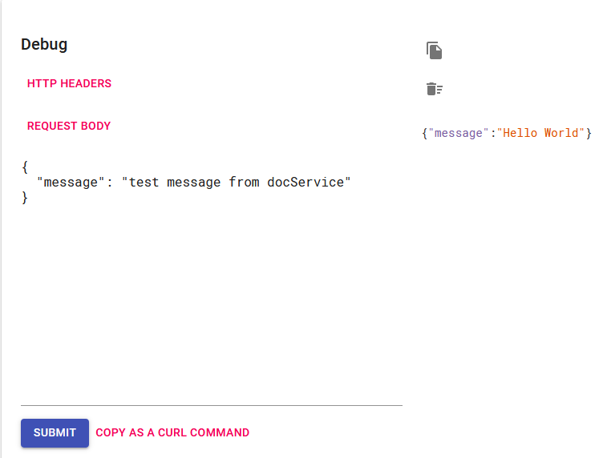
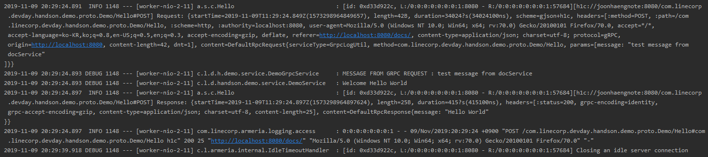
3.7 docService Connection
Perform a Hello () test

Slide 24
3.8 Something is missing?
While configuring gRPC we did not configure port
Libraries used to support gRPC in Spring need a separate port
grpc-spring-boot-starter
reactive-grpc
And so on…
If we use it in our hands-on manner, Armeria's server implementation (ArmeriaWebServer) replaces reactor-netty
Incoming HTTP request to Spring WebFlux…
When a gRPC request comes in, gRPC service…
When a Thrift request comes in, the Thrift service…
Let Armeria handle network level and Spring coexist to secure Bean Container and Spring ecosystem
It is based on Spring WebFlux for bean management and other Spring ecosystem libraries (Spring Cloud, etc.)
Allow Armeria to manage gRPC, Thrift, etc. that Spring doesn't support
Support gRPC and thrift in a single application with minimal extra labor
IDL compilation work is what you need to do to use gRPC or thrift anyway
Works as a direct configuration in Armeria without using a separate port or implementation

Slide 25
4. Apply ArmeriaClient

Slide 26
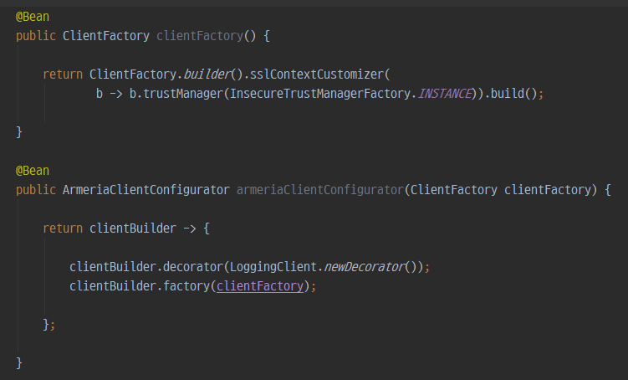
4.1 ArmeriaClient Settings
Spring WebFlux's WebClient implementation can also be changed to Armeria
Add ArmeriaClientConfiguration setting
insecureClientFactory is a code that configures to bypass SSL certificate verification
Do not set in production environment
Omitting LoggingClient.newDecorator(), application works but does not print to log client relative information

Slide 27
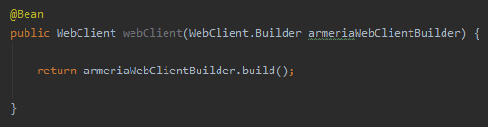
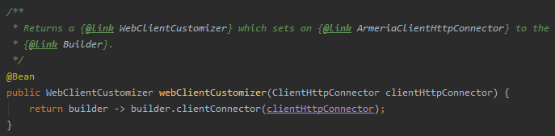
4.1 ArmeriaClient Settings
Spring WebFlux's WebClient implementation can also be changed to Armeria
Inject WebClient.Builder and need separate build
ArmeriaServer is applied immediately after declaration, but ArmeriaClient needs to be injected once more and used to build as WebClient implementation.
See com.linecorp.armeria.spring.web.reactive.ArmeriaClientAutoConfiguration.java for reason that before definition

Slide 28
4.2 JSON Mock Server
We use postman-echo
We use https://postman-echo.com/ for mock json response server
When we send request such as https://postman-echo.com/get?foo1=bar1&foo2=bar2
Postman-echo return as below
Only the [args] part is used here and the rest are ignored.
{
"args": {
"foo1": "bar1",
"foo2": "bar2"
},
"headers": {
"x-forwarded-proto": "https",
"host": "postman-echo.com",
"accept": "*/*",
"accept-encoding": "gzip, deflate",
"cache-control": "no-cache",
"postman-token": "f55c40a0-8e0b-4ab9-b310-e645fe1732df",
"user-agent": "PostmanRuntime/7.19.0",
"x-forwarded-port": "443"
},
"url": "https://postman-echo.com/get?foo1=bar1&foo2=bar2"
}

Slide 29
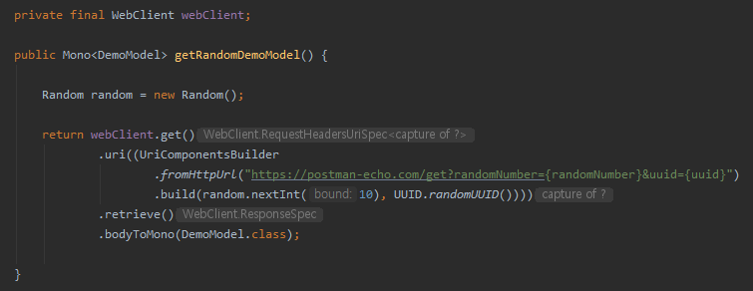
4.3 create Controller, Service, Model
Add code and model class to call mock server
Add some code to DemoService.java which test with json-mock server

Slide 30
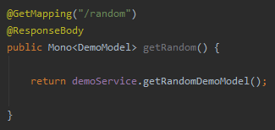
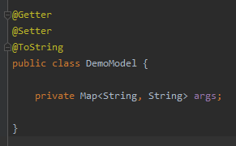
4.3 create Controller, Service, Model
Add code and model class to call mock server
Add some code to DemoController.java for call demoService.getRandomDemoModel()
Create DemoModel.java

Slide 31
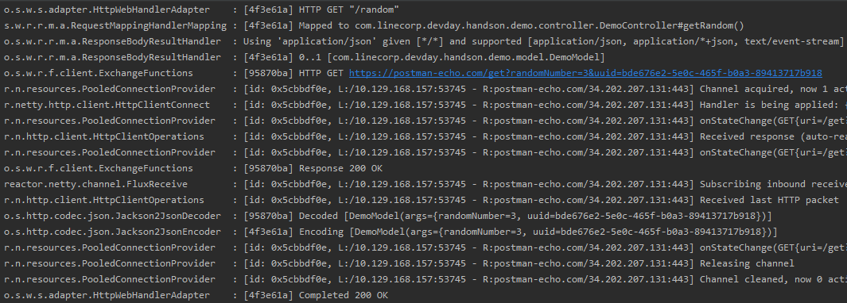
4.4 Check operation
Make sure it's running on the ArmeriaClient

Slide 32
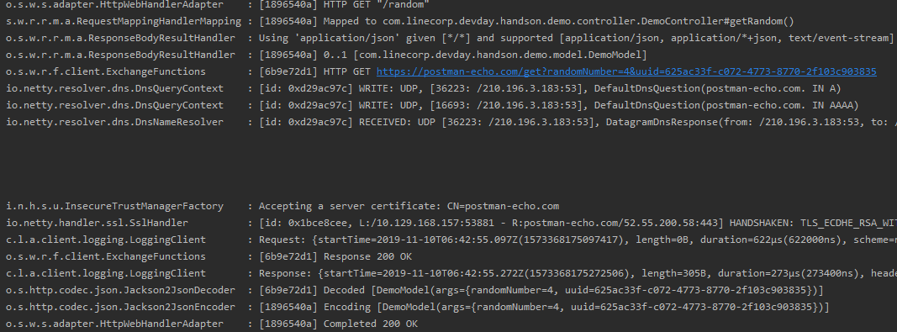
4.4 Check operation
Make sure it's running on the ArmeriaClient

Slide 33
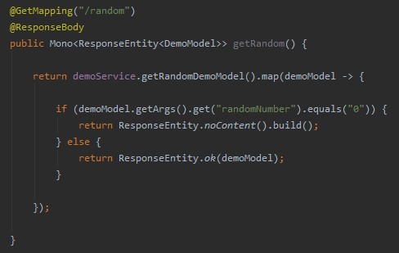
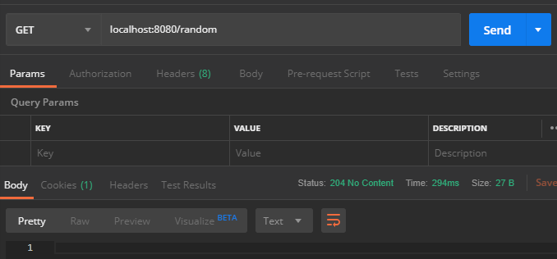
4.5 Other usage
Can be used exactly like WebFlux's native WebClient
Of course it is possible

Slide 34
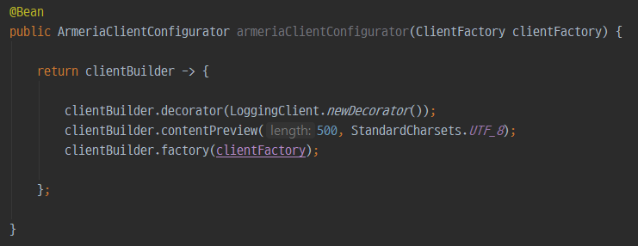
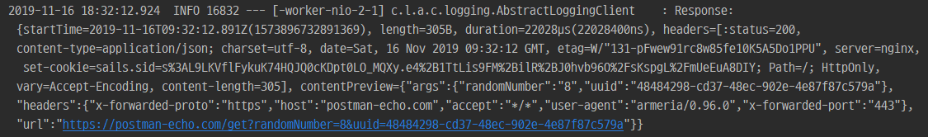
4.6 Question
If it is 0, I decided to process NO_CONTENT…
Did "0" really come from the server?
Checking RAW data from a server, one of the most troublesome ones based on WebFlux
There are ways to use ExchangeFilterFunction etc, but it's complicated
You can see RAW DATA from server with one line setting
Show up to 500 characters

Slide 35
5. Create Decorator

Slide 36
5.1 The need to interrupt
We used ContentPreview earlier…
ContentPreview supports text series type in common
when its type matches text/* or application/x-www-form-urlencoded
when its charset has been specified. e.g. application/json; charset=utf-8
when its subtype is xml or json. e.g. application/xml, application/json
when its subtype ends with +xml or +json. e.g. application/atom+xml, application/hal+json
https://line.github.io/armeria/advanced-structured-logging.html#enabling-content-previews 참고
Recently, mainly JSON type
JSON is much easier to see with pretty prints than with single lines of text.
There seems to be no option to display JSON as pretty print, so let's make it ourselves

Slide 37
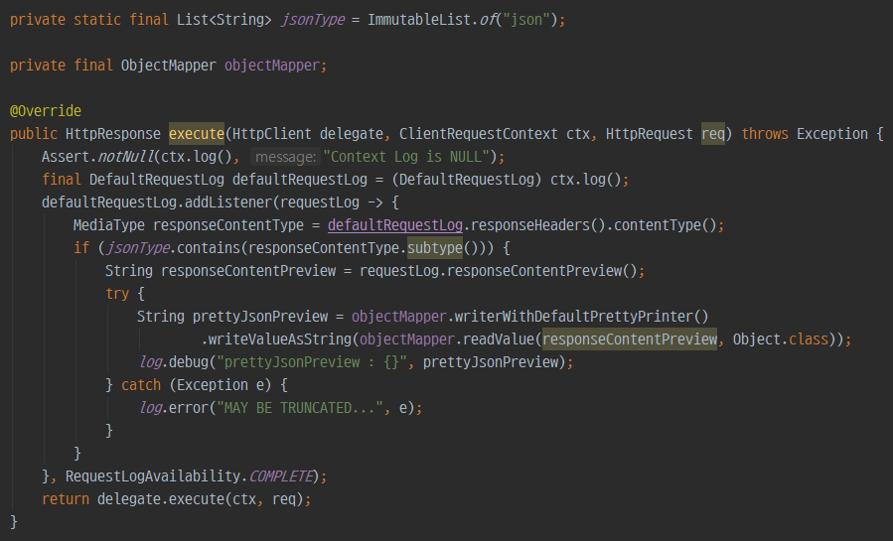
5.2 Decorator
We’re curious about the values coming from the server, so We write a Decorator for the Client
Create PrettyJsonPreviewClientDecorator.java

Slide 38
5.2 Decorator
Code Description
Register a listener after obtaining RequestLog object with ctx.log()
At this time, the listener is set to RequestLogAvailability.COMPLETE at the time when both request and response are ready.
Check if the server response is json type ..
Get the value of the ContentPreview, objectize it with json and print it pretty
Jackson and Gson have no way to pretty print json strings
Inevitably, we use the method of objectifying json string once and then pretty printing it again
That is, it is recommended to use this decorator only in the development environment because it may cause a decrease in performance when it is set in the operating environment.
If the length of ContentPreview is set shorter than the response from the server, the response is truncated and may not be in json format.

Slide 39
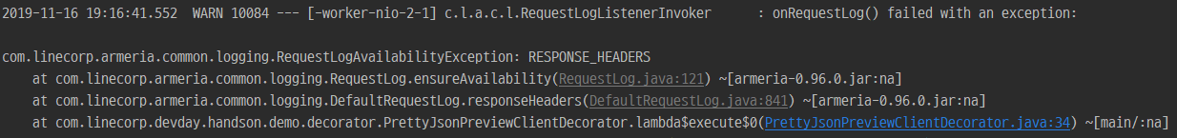
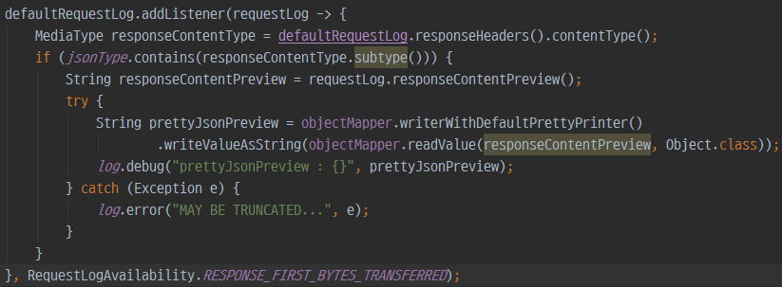
5.2 Decorator
RequestLogAvailability
Do not print at any time when printing logs
What if the server didn't give a response and you try to access it?

Slide 40
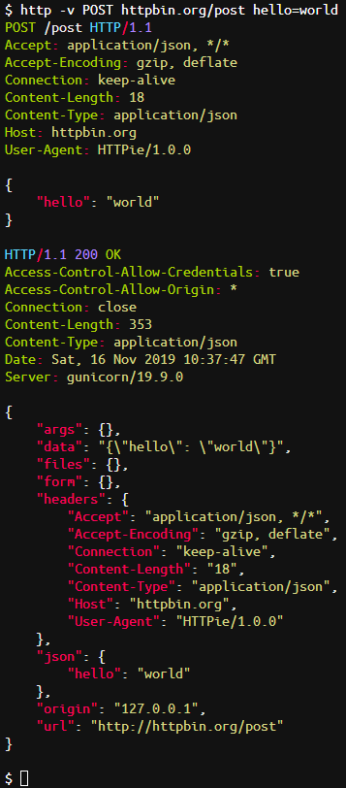
5.2 Decorator
Request
REQUEST_START
SCHEME
REQUEST_FIRST_BYTES_TRANSFERRED
REQUEST_HEADERS
REQUEST_CONTENT
REQUEST_END

Slide 41
5.2 Decorator
Response
RESPONSE_START RESPONSE_FIRST_BYTES_TRANSFERRED
RESPONSE_HEADERS
RESPONSE_CONTENT
RESPONSE_END COMPLETE (Complete ALL)

Slide 42
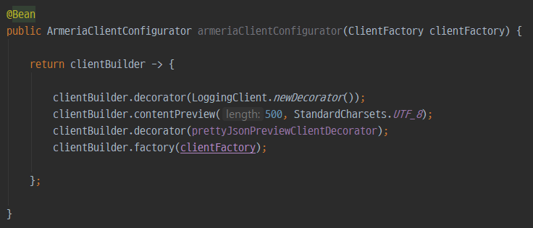
5.3 Apply Decorator
Apply your Decorator to ArmeriaClientConfiguration
Add code to ArmeriaClientConfiguration.java for use our custom decorator

Slide 43
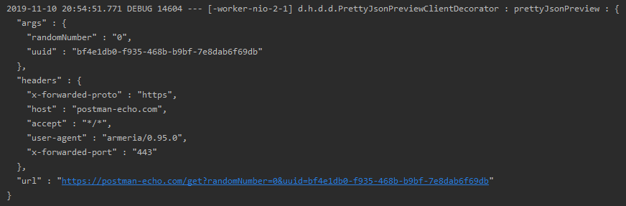
5.4 Check the result
Check if it is properly applied after startup

Slide 44
6. Other Tip

Slide 45
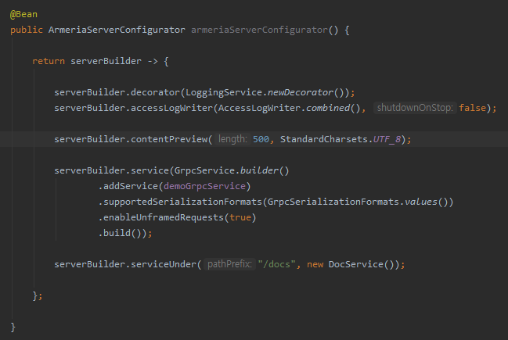
6.1 Preview of Server can also be viewed
You can also read the preview of the text leaving the server with one additional line
One more line below…

Slide 46
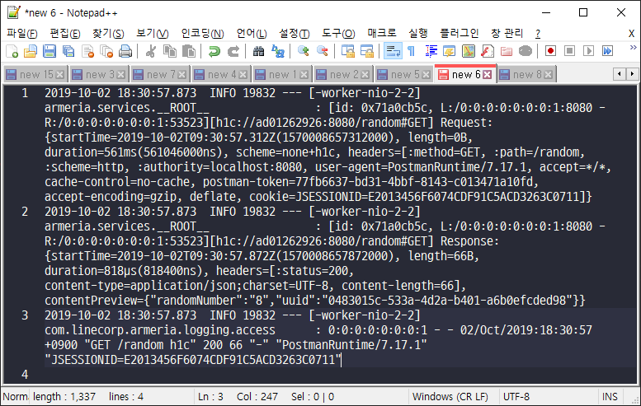
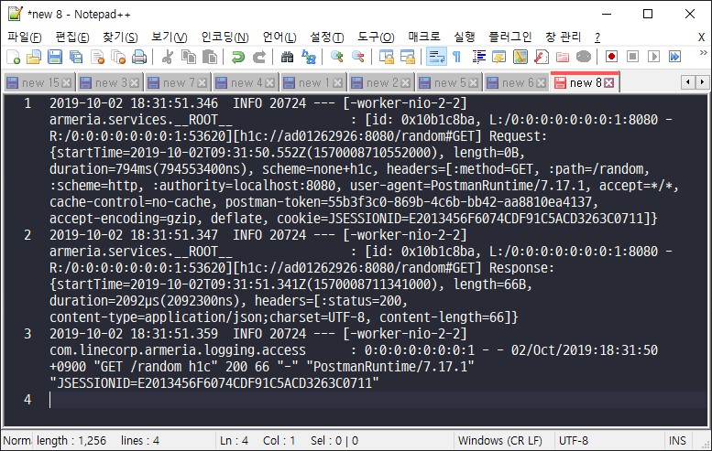
6.1 Preview of Server can also be viewed
You can also read the preview of the text leaving the server with one additional line
Preview is taken in the log

Slide 47
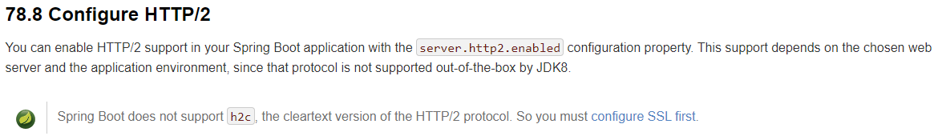
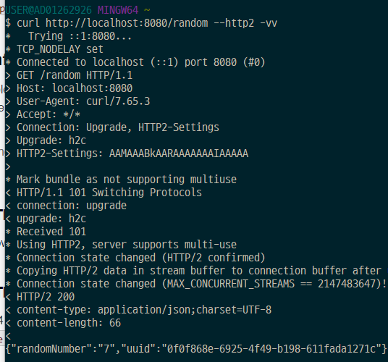
6.2 h2c is supported by default
h2c (HTTP/2 with cleartext) is supported by default without any setup
Spring Boot only supports h2, not h2c
Armeria makes it possible to use h2c

Slide 48
6.3 When DNS Problems Occur
When there is a problem with DNS
I'm not sure, but it's possible that some windows machines have problems with DNS
https://github.com/line/armeria/issues/2243
If you experience any of these issues, you can temporarily avoid them by applying the options below
-Dcom.linecorp.armeria.useJdkDnsResolver=true
https://github.com/line/armeria/pull/2261

Slide 49
- End of Document - Thank You. -

